Slide 1
FERRITE CIRCULATOR
Introduction……………
WHAT IS A FERRITE CIRCULATOR
ferrite circulator is a three-port device used to control the direction of signal flow (RF energy) in a circuit.
It is a non-reciprocal, passive three ports, ferromagnetic device in which power is transferred from one port to the next adjacent port in a prescribed order

Slide 2
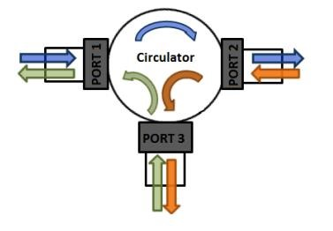
DIAGRAM OF A CIRCULATOR
A simple diagram of a circulator

Slide 3
WORKING PRINCIPLE OF A CIRCULATOR
A Circulator utilizes a transversely magnetized ferrite junction to circulate incoming microwave energy from port 1 to
port 2, port 2 to port 3, and port 3 to port 1.
The arrows represent the direction of the magnetic fields and the signal when applied to any port of these devices.
An RF signal experiences a low loss in the direction of arrow and high loss in reverse direction while propagating through the Circulator

Slide 4
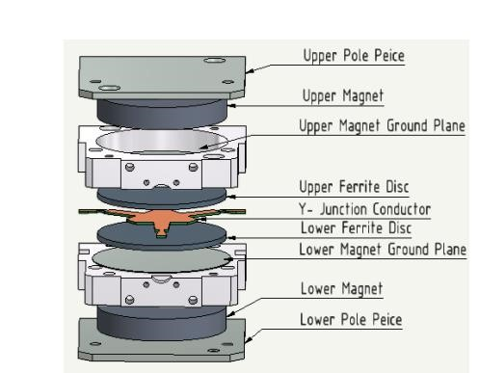
CONSTRUCTION ELEMENTS OF CIRCULATOR
A simple diagram that shows different internal parts of circulator

Slide 5
CONSTRUCTION ELEMENTS OF CIRCULATOR
Typical junction Circulator consists of
A Y- junction strapline circuit sandwiched between two ferrite discs
An upper and lower magnetically biased permanent magnets
Ground planes.
The ferrite materials, magnets are selected according to the frequency of operation, input power ratings and intended application.
,
The magnetic field is applied through the vertical axis of this assembly, results into a circulation of the RF energy from one port to the adjacent port, depending on from which port the energy is coming from

Slide 6
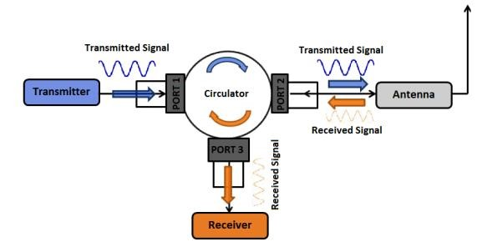
APPLICATIONS OF THE CIRCULATOR
1. AS RF duplexer
It can be used as an RF duplexer to share the same antenna between transmitter and receiver which are tuned to different frequencies.
This configuration allows bidirectional communications over a single channel.

Slide 7
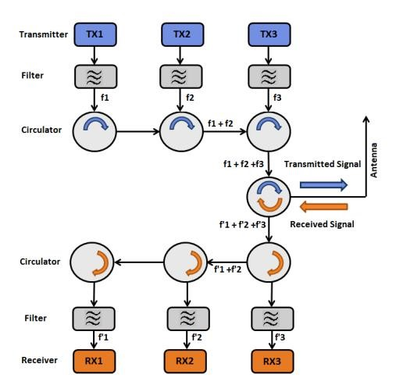
APPLICATIONS OF THE CIRCULATOR
2. Radio Link Combiner:
A Circulator can be used as an RF signal combiner for multiple transmitters and receivers in the VHF/UHF bands.
For radio links operating at 2 GHz and higher frequencies the conventional combining technique using an array of sharp filters, results in relatively high losses

Slide 8
APPLICATION AREAS:
Television & Radio broadcasting
Radio links & telecommunication networks
Aviation & navigation industries
Military equipment & Radar systems
Laboratory measurement systems
Industrial microwave heating.

Slide 9
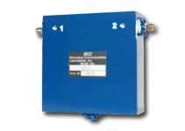
HOW IS CIRCULATOR PACKAGED.
It’s generally offered as the discrete devices in shielded metal cans with appropriate connectors for the input and output ports

Slide 10
Limitations of circulator devices
It more sized and bulk make then incompatible with today’s miniature products which must, therefore, use alternative approaches which are only available at lower power level.
It is difficult to achieve acceptable performance beyond tens and hundreds of GHz.

